Slide 1
Extensis Portfolio
A Brief How-to
Desktop Client

Slide 2
Connecting to Portfolio Server
Link to download Portfolio's desktop client: http://www.extensis.com/portfolio-server-11/download-professional/
Once it's finished downloading, add the IP address: pres-port-p01.austin.utexas.edu and the name UT Portfolio
Login to Portfolio using the Desktop Client by clicking on the Portfolio icon.
Your username should be your EID with the same password. If this does not work, see the Digital Asset Manager.
To download the server must be mounted. The server address is: smb://pres-port-p01.austin.utexas.edu

Slide 3
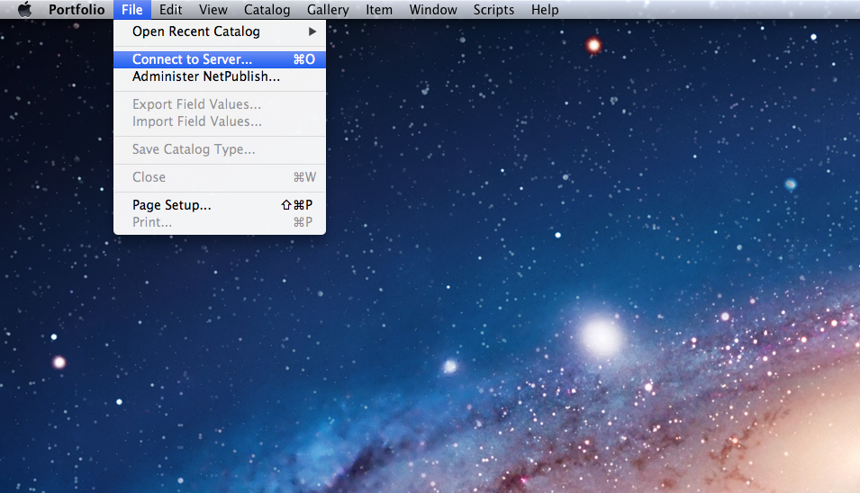
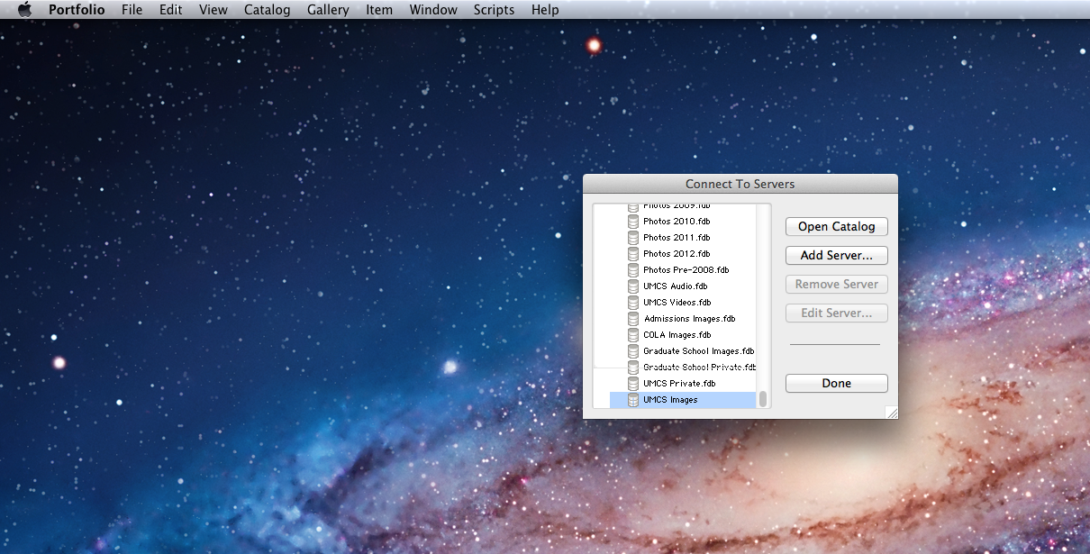
Open Catalog
Portfolio → File → Connect to Server
Select a catalog based on department. You can select more than one.

Slide 4
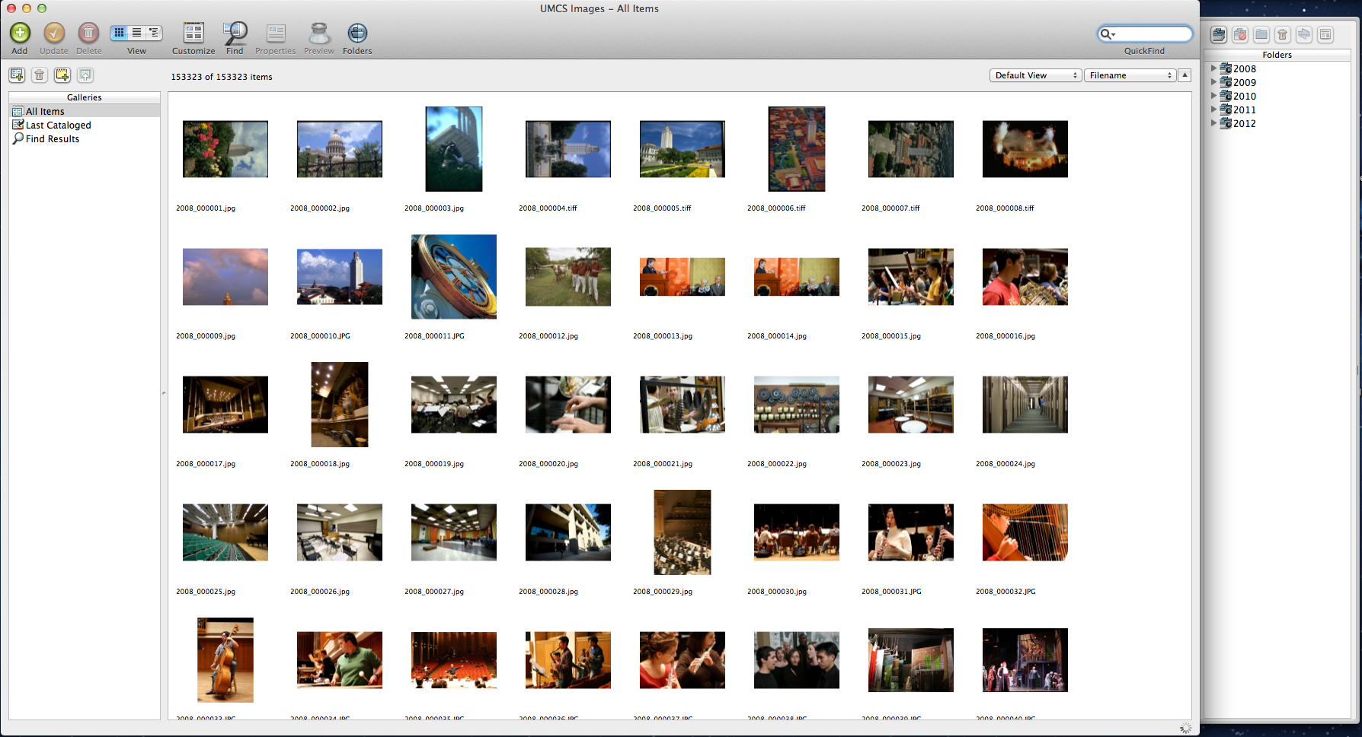
Catalogs
Select the catalog you want to upload to from the list on the right hand column (or search across all of them).
Notes:
I’m not sure what you mean by that parenthetical phrase. Search across all of them to upload? The meaning is ambiguous to me.

Slide 5
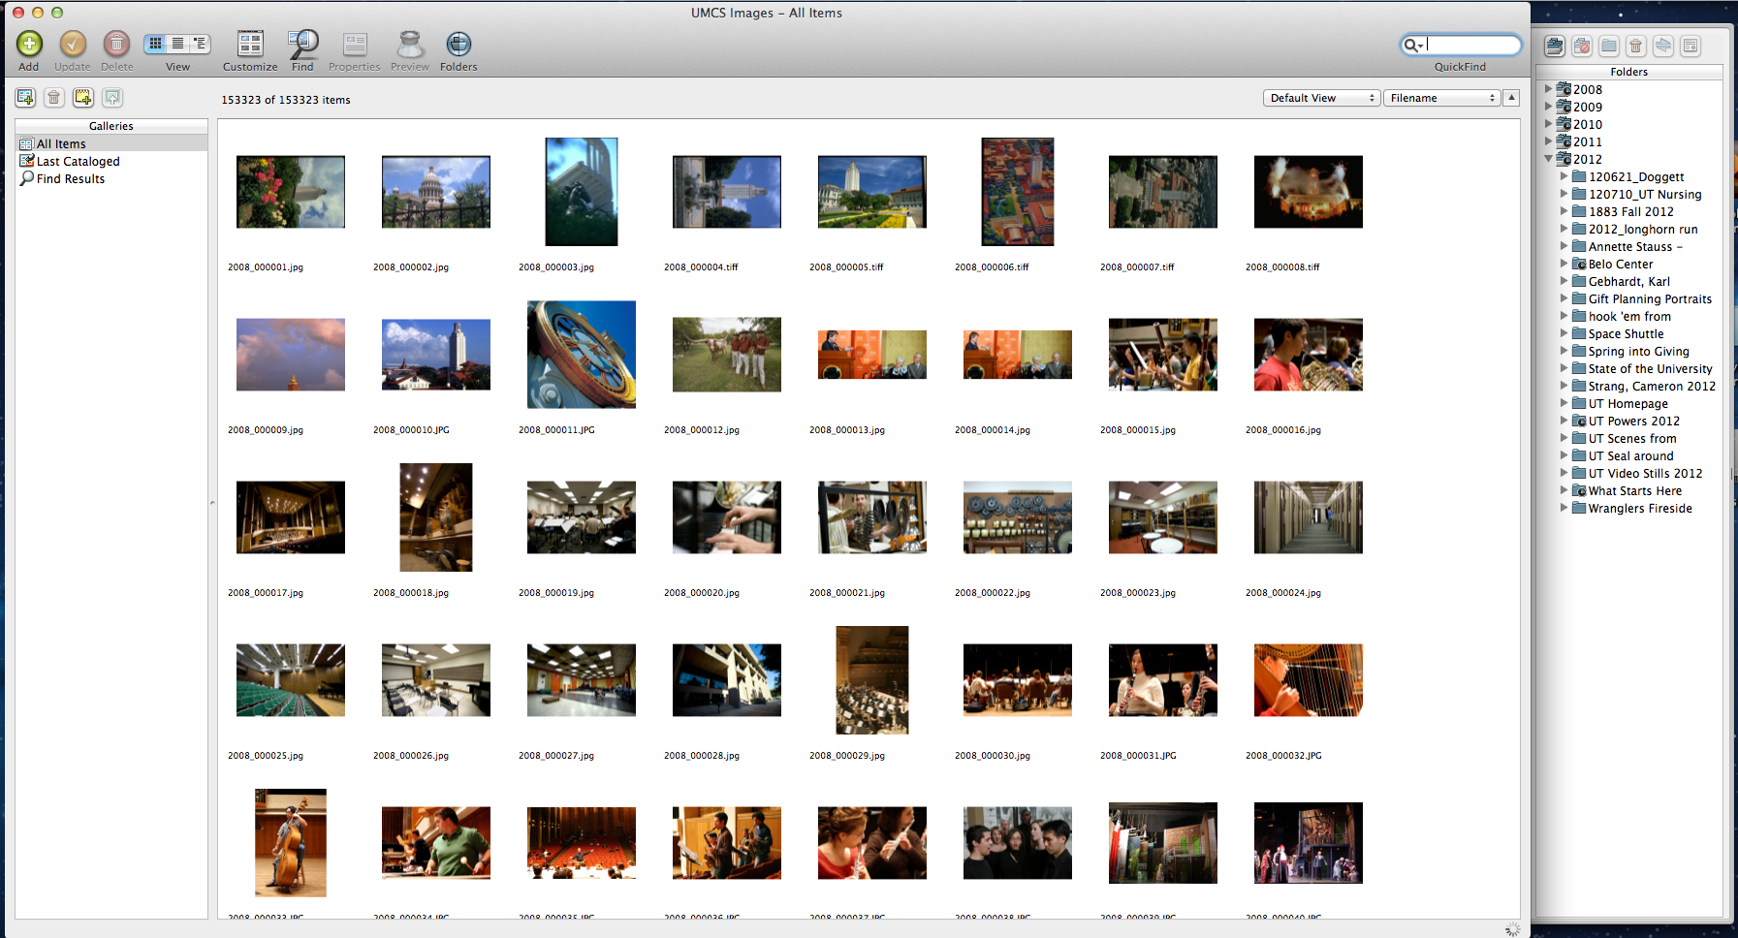
Click the triangle next to the catalog name to display the folders in the catalog
This will give you the list of the originating events for the files if you want to find something specific.

Slide 6
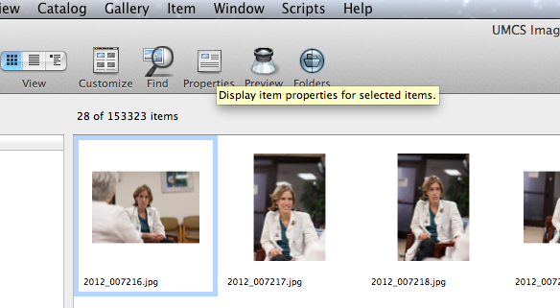
Select Properties for Metadata

Slide 7
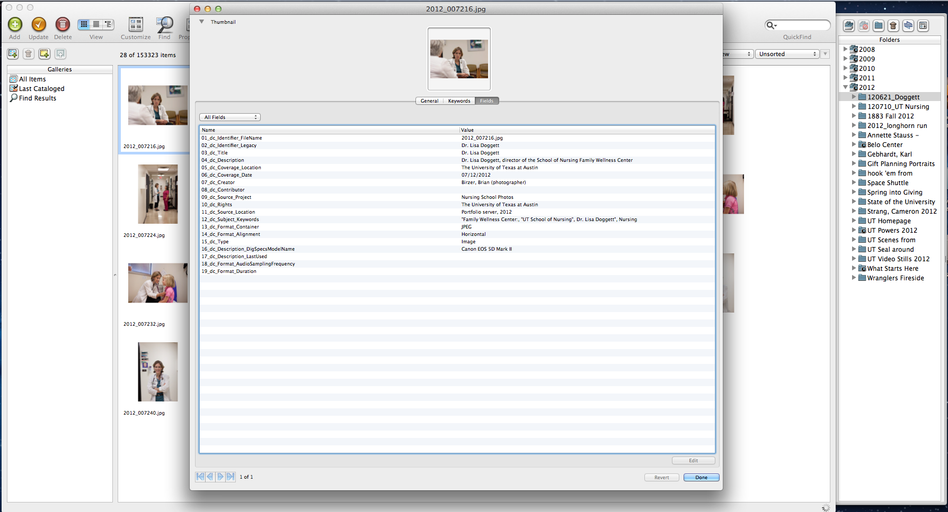
Metadata Fields
You can edit each field by selecting a field and then selecting Edit.

Slide 8
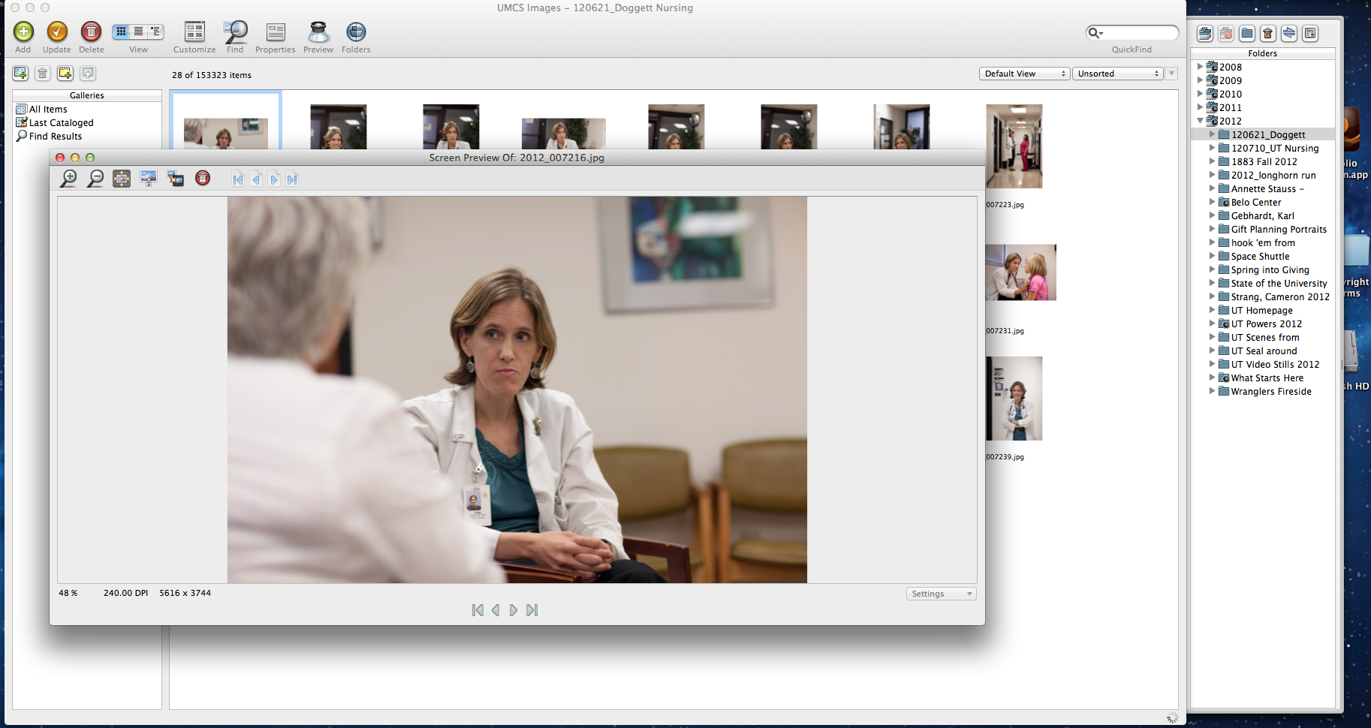
Close-up
Double click the thumbnail for a close-up

Slide 9

Searching

Slide 10
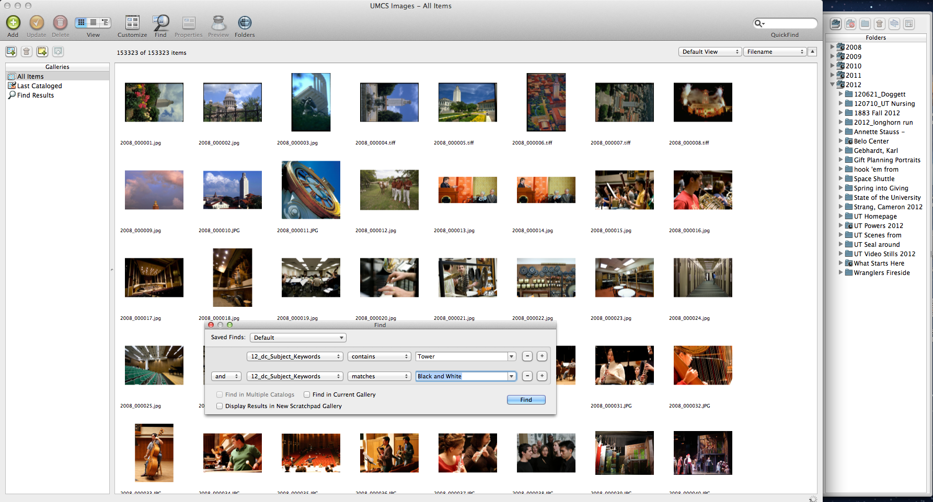
Advanced Search
Select “find”, with the magnifying glass icon

Slide 11
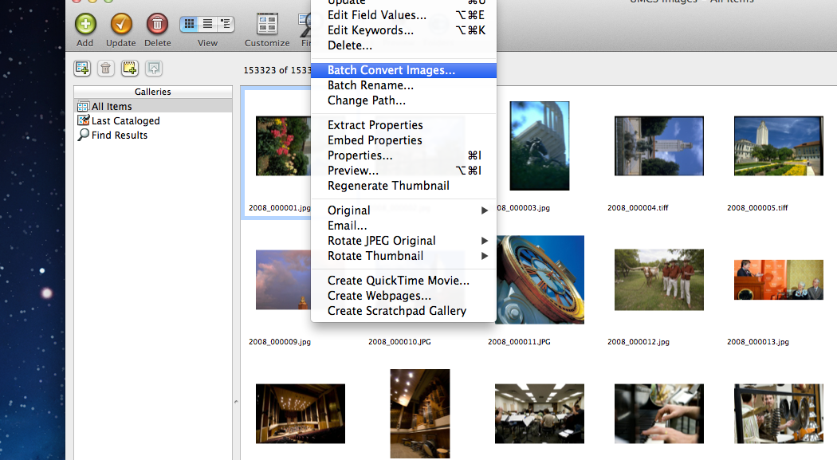
Batch Convert
Item → Batch Convert Images

Slide 12
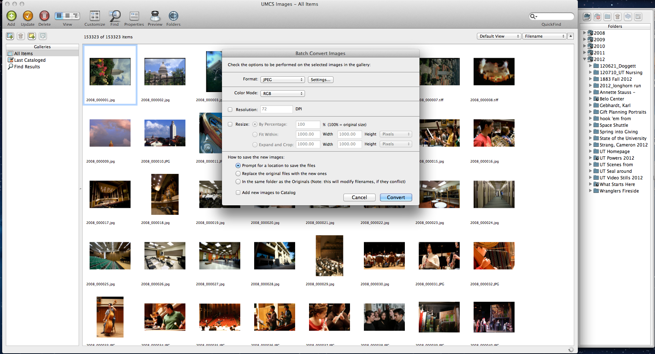
Edit specs

Slide 13
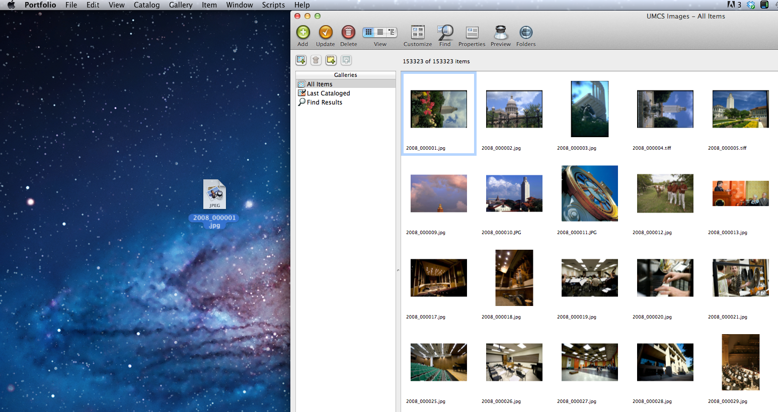
Download
Drag and drop to your desktop. The server must be mounted.

Slide 14
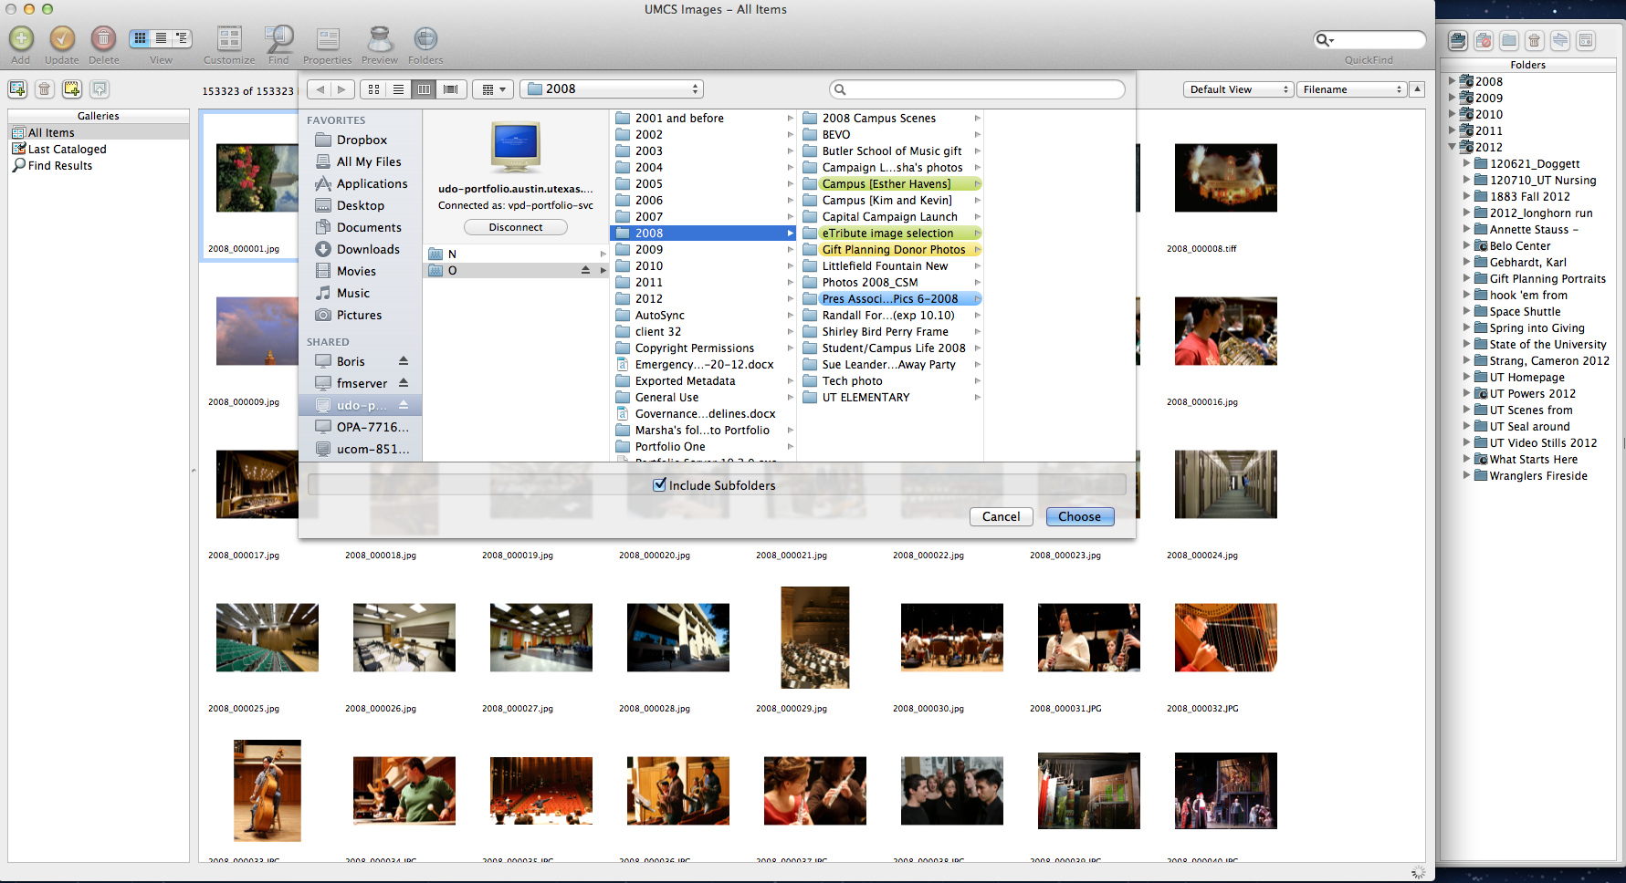
Upload
Select add.

Slide 15
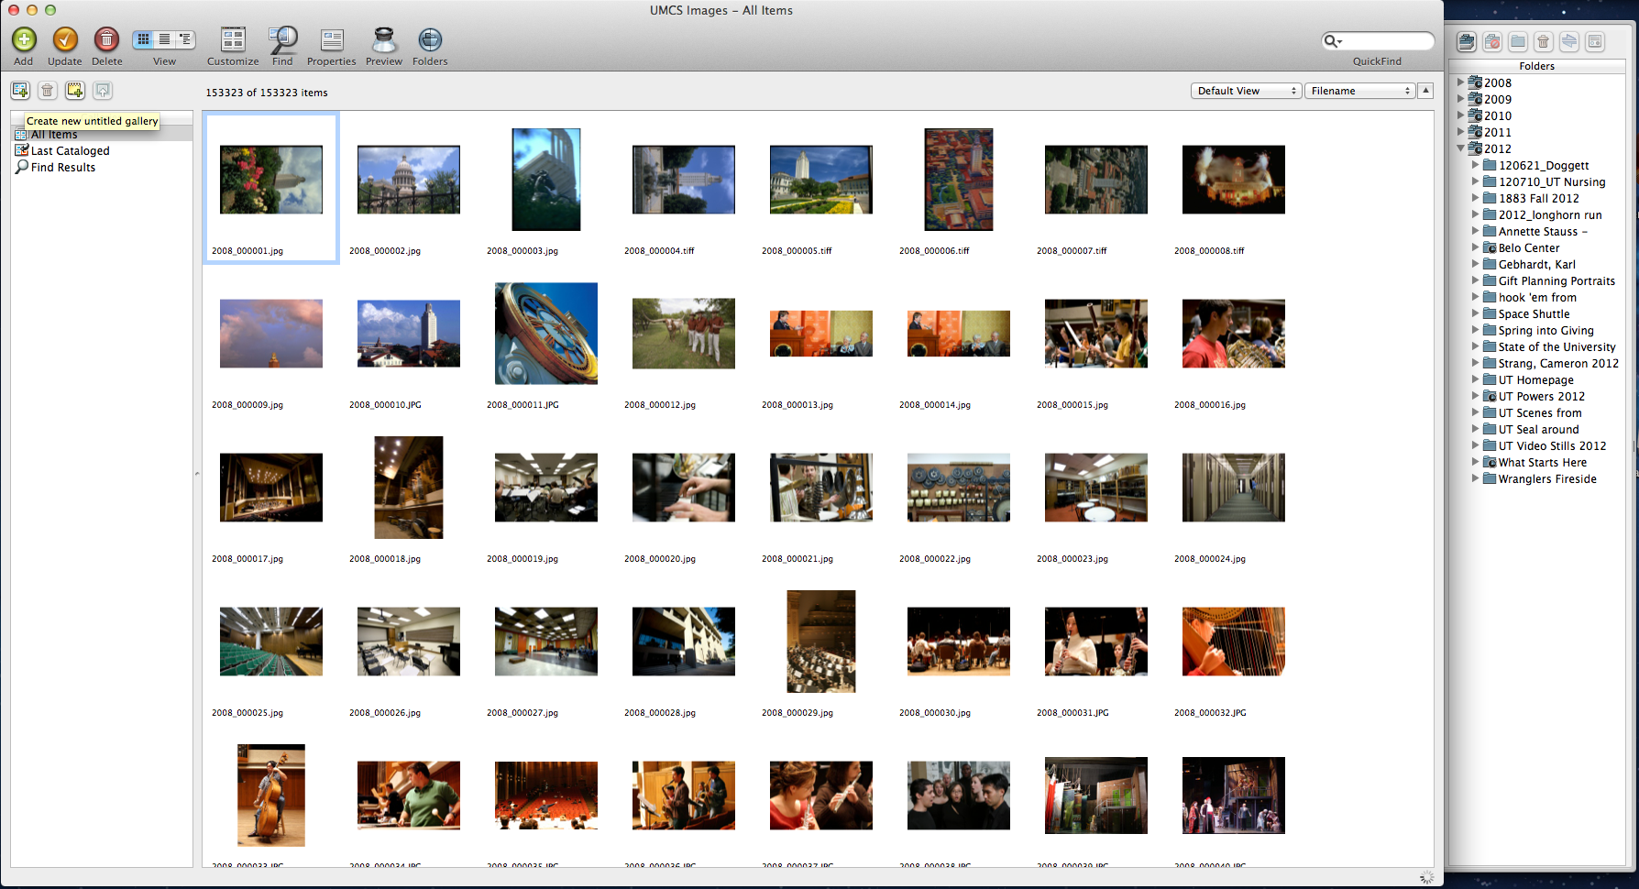
Creating a Gallery

Slide 16
User Accounts and Permissions
User accounts will be created by the Digital Asset Manager. All users in the department will have accounts as well as designated users in the CSUs. Permissions will depend on user needs.
Access Levels
Catalog Administrator: This level allows access to all functionality available. Catalog Administrators have access to advanced operations in the Portfolio Desktop Client, like editing custom fields, metadata mappings, and AutoSync folder settings. Catalog Administrator access should not to be confused with the Portfolio Server Administrator, who has access to all server settings.
Publisher: Publishers are able to upload and delete items from a catalog as well as update all metadata for files in the catalog. Publishers can also create galleries.
Editor: Editors are able to modify metadata, such as entering keywords and custom field values. Editor level and above can batch process, or, download files to their computer.
Reader: Readers may only view items in the catalog and download files. They cannot add or remove items or edit metadata.
Most users in the University Marketing and Creative Services department will be designated as Publishers or Editors. CSUs will each have their own Catalog Administrator to manage their assets.

Slide 17
Questions?
Please contact Rachel Appel, Digital Asset Manager, with any questions or feedback
rappel@austin.utexas.edu
512-232-2324

